Slide 1

VIRTUAL CONFERENCE
DOCKER
Donnie Hamlett
Twitter: @donnieham1
E-mail: dh@recruit4cloud.com

Slide 2

Intro
Education: BSEE
IT for over 16 years, Sys. Engineer
Past: Microsoft, Cisco, CloudStream, iQuate
Present: Recruit4Cloud, ServiceNow
President of OpenStack Central Fl. User Group
Community Cloud Project
@openstack_cfl, openstackcfl.org
Board of Directors for WIL

Slide 3
Docker – Session Objective
By the end of Class you should be able to:
Explain what a Container is
Understand why Docker Containers are a game changer
Find documentation on how to install Docker
Understand the basic Docker commands
Run WordPress within a Docker Container

Slide 4




History of Docker and Containers
Container like technology has existed for many years in the UNIX world.
FreeBSD – Jail Utility(1998)
Solaris – Zones (2001)
Parallels – Virtuozzo Linux (2001)
OpenVZ (2005)
Google (2007)- CGroups for Linux
Linux Container Project LXC -2008
The core of the technology is based on Named Spaces and Unix CGroups
Powerful but not popular because it was difficult to use

Slide 5

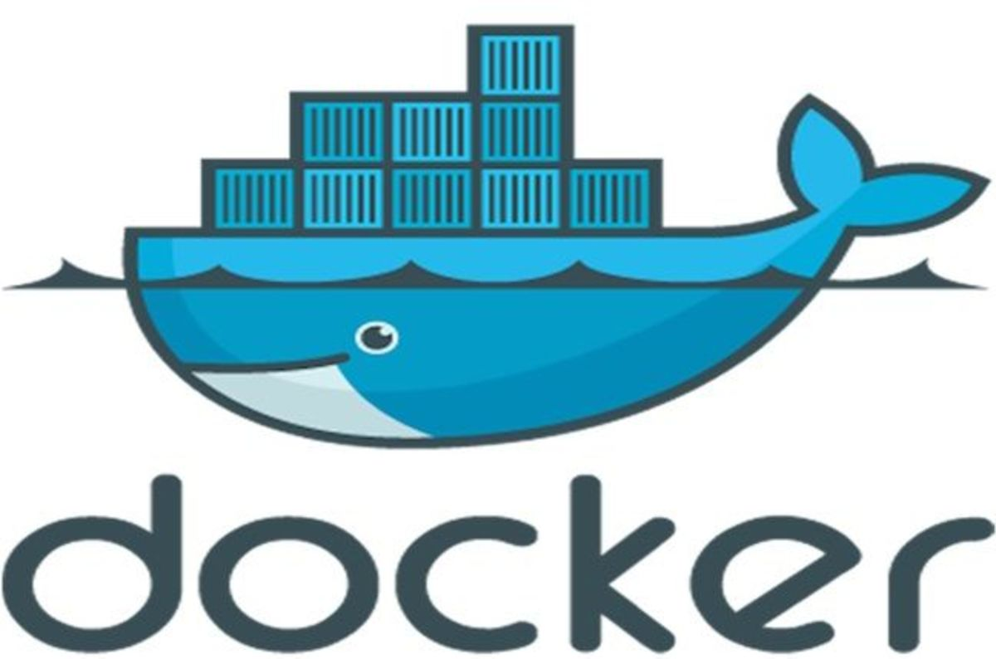
Docker Makes it Easy
Founder: Solomon Hykes (2013)
Written in GO Lang
User Friendly Interface
Docker Engine: creates and runs containers (All Platforms)
Docker Hub: makes it easy to download images
A docker is a type of waterfront workman

Slide 6



What’s the big deal?
< DENSITY !!!! >
App on Hardware
Guest VM’s on Virtual Server
Guest Containers on a Server

Slide 7
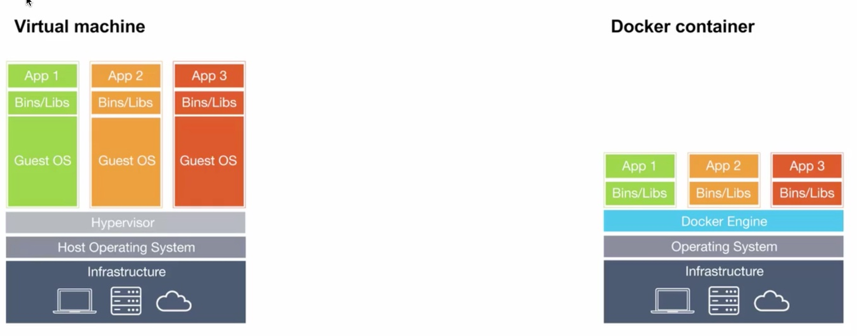
Virtualization & Containers

Slide 8

But wait there’s more!
Smaller
Better for development
Start Faster
Make Better use of Storage
Easier to Monitor
Incredibly Scalable and Highly Available
Swarm
Mesos
Kubernetes

Slide 9
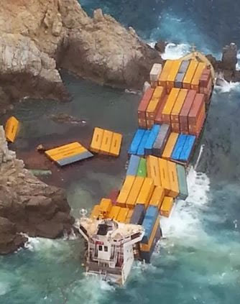
There is a downside ☹
Only one OS (Kernel)
Security
Not all applications run in a container

Slide 10
Getting Started
If you are new to Linux use Ubuntu with Unity
Sign Up for GitHub Account (github.com)
Sign Up for a Docker Hub Account (hub.docker.com)
Follow the directions on the Docker website for installation (docker.com)

Slide 11
DEMO
Google “ install docker “
Follow the directions on the Docker website (all of them)
We are using Ubuntu 14.04 LTS

Slide 12
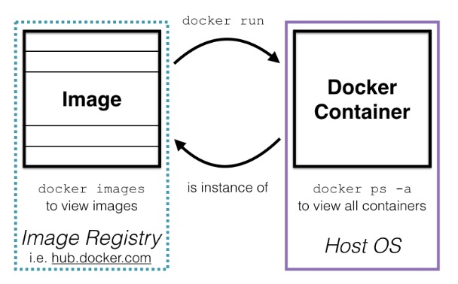
Docker Image > Docker Container
https://blog.newrelic.com/2016/06/20/docker-osx-mac/

Slide 13
DEMO
We are using Ubuntu 14.04 LTS

Slide 14
Anatomy of Docker Command
All Docker commands a begin with Docker
docker –-version
docker run busybox /bin/echo “Wassup”
docker help

Slide 15
A closer look at Containers
docker images
docker ps (running containers)
docker ps –a (all container info)
docker logs foo (logs for the container)
docker inspect foo (examine the container)

Slide 16
Interacting with a Container
docker run –it busybox /bin/bash
i flag means interactive
t flag means to provide a terminal
once inside the container can do anything you would do in a normal Operating System type exit to leave Containers shell

Slide 17
Interacting with a Container
docker run –d -p 8000:80 nginx
d flag means detach (it runs in the background)
p flag means port yourcomputer:container
You can curl localhost:8080

Slide 18
Saving your Container
docker commit –a “Donnie Ham” –m “info” specialnameofimage donnie:test
a flag means author
m flag is for metadata (info about your container)
donnie:test is the name of the new image
* note: the name of your image “xxxx:xxxx” must be all lowercase (a-z characters)
docker images commit

Slide 19
Congrats ☺ You now know Docker!
Full disclosure: You only know a little bit but it’s a great start

Slide 20

Just the Beginning
There is so much more you can do with Docker but you now know enough to get started.
Challenge: Use what you learned in todays session to build a WordPress Container.

Slide 21

Thank You!
Email: dh@recruit4cloud.com
Twitter: @donnieham1

